Slide 1
HVAC Energy Efficient Design
No.11 Group
Pre: Ziying Lan

Slide 2
TABLE OF CONTENTS
01
02
03
04
Definition and Principle
Importance of HVAC
background objectives for the design
Significance of HVAC in green buildings
Design of HVAC
Conclusion
Design method of green building HVAC system
Our conclusion and future proposal

Slide 3
01
Definition and Principle
background objectives for the design

Slide 4
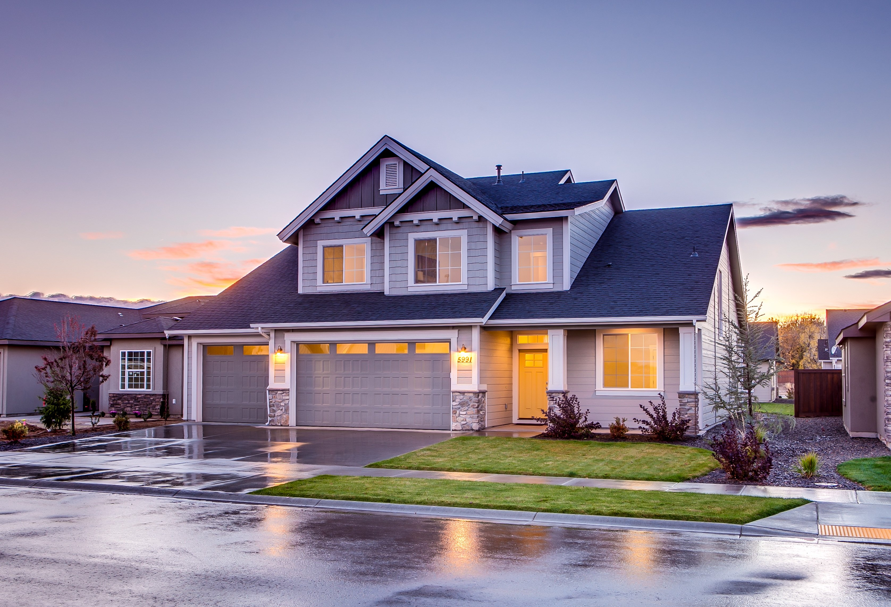
Definition and Background
Definition
A green building is a building that is designed, constructed, used and dismantled in such a way as to minimise its impact on the environment, improve the health and comfort of its occupants, and achieve sustainable development.
Background
The double carbon target proposal emphasizes the urgency of energy saving and carbon reduction in industrial buildings. Safety, production efficiency, and reducing energy consumption are key priorities in industrial buildings.
11

Slide 5
Objectives in total
Enercare
Sustaina
Energy Efficiency and Environmental Protection
A
Prioritize long-term sustainability and resource management.
B
Circular Economy
F
Flexadapt
maximizing resource efficiency
C
Integration and Adaptability
Humanfocus
E
IConnect
D
Venus has beautiful name but is hot
Intelligent IoT for the Whole Building Cycle

Slide 6
02
Importance of HVAC
Significance of HVAC in green buildings

Slide 7
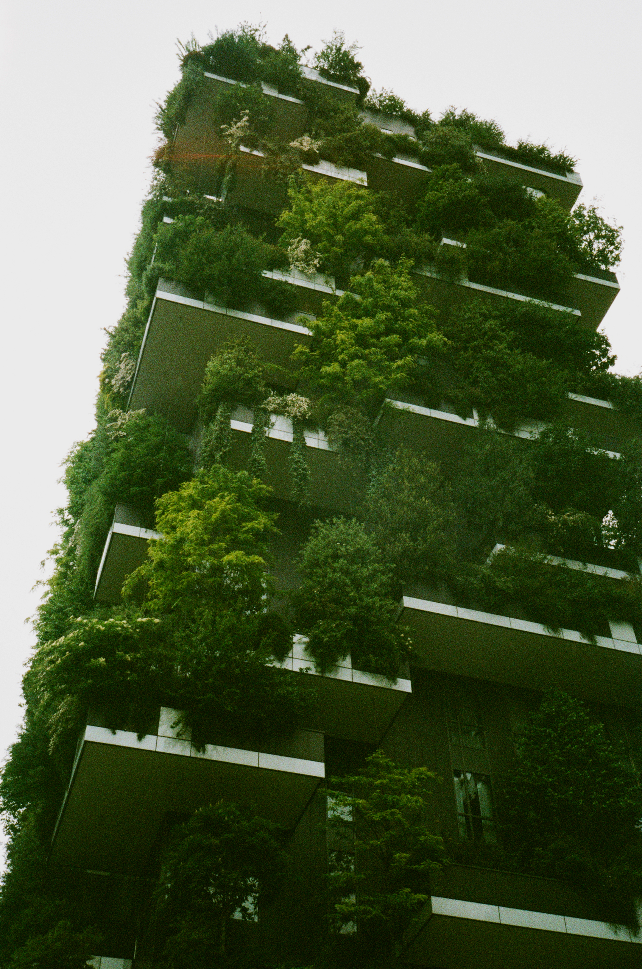
The Significance of HVAC
HVAC design is a crucial component of green buildings, and its thermal performance has a significant impact on building energy consumption, occupant comfort, and indoor air quality. The importance of studying the thermal performance of HVAC lies in the fact that HVAC is one of the main sources of energy consumption in buildings, and its performance in terms of thermal insulation, indoor lighting and air quality directly affects the energy consumption of buildings and the comfort of users. Therefore, it is of great importance to test the thermal performance of HVAC and assess its comprehensive performance.
11

Slide 8
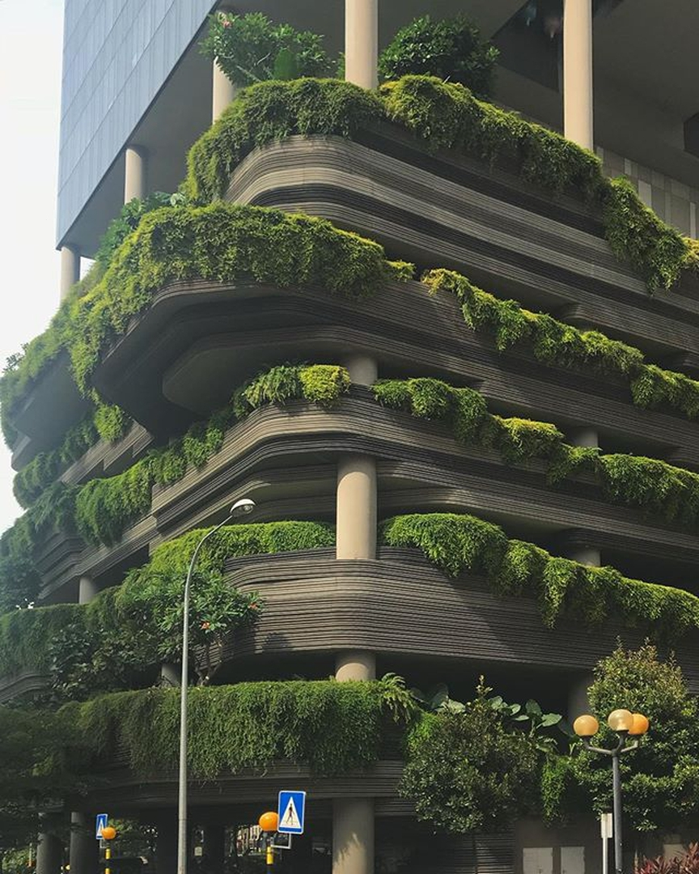
The Significance of HVAC
The methods for testing and evaluating the thermal performance of HVAC have been continuously improved and refined. The purpose of studying the testing and assessment methods of HVAC thermal performance is to better meet the needs of green buildings, to improve the efficiency and saving of building energy consumption, and also to improve the comfort of the building and the health of the users.
11

Slide 9
03
Design of HVAC
Design method of HVAC system

Slide 10
Solar
When choosing air conditioning cold and heat sources, it’s crucial to consider factors like investment, costs, energy consumption, reliability, safety, environmental impact, service life, and room area. Additionally, energy structure, prices, policies, urban planning, and local conditions should be taken into account.
Solar energy and other renewable energy sources

Slide 11

Daylighting and lighting systems
In green building HVAC design, the lighting system plays a crucial role in creating a comfortable and efficient indoor environment. By utilizing natural light sources and advanced lighting technology, energy consumption can be reduced, lessening the environmental impact. Optimized daylighting and lighting design enhances energy efficiency, decreases carbon emissions, and improves occupants’ visual comfort, thereby enhancing their quality of life and work.
11

Slide 12
Ventilation
The natural ventilation and ventilation system aims to enhance air circulation, indoor air quality, energy efficiency, and user comfort through well-designed techniques. It operates based on climate, building form, and air pressure differences, requiring no additional energy consumption, mak-ing it cost-effective and environment-ally friendly.
Natural ventilation and ventilation systems

Slide 13

Heating and cooling zones
Cooling and heating partitioning involves dividing a building into different temperature zones for refined energy management. In HVAC design, factors such as building layout, materials, climate, and usage must be considered for developing a suitable partitioning scheme. Efficient controls should be selected to reduce energy consumption and enhance convenience.
11

Slide 14
Mitigation
The heat island effect refers to higher temperatures in urban areas due to human activities, dense buildings, and insufficient green coverage. Effective mitigation measures, like high-reflectivity materials, green building design, and increased urban greenery, can reduce heat absorption, improve the climate, and decrease energy consumption.
Mitigation measures for
the heat island effect

Slide 15

Renewable resources
Solar energy and other renewable sources are crucial in green building HVAC design, reducing reliance on traditional energy and minimizing the environmental burden. By utilizing solar photovoltaic panels, solar water heaters, and considering natural conditions like sunshine and wind power, designers can maximize energy efficiency, reduce carbon emissions, and promote sustainable development while protecting the ecological environment.
11

Slide 16
04
Conclusion
Our conclusion and future proposal

Slide 17
CONCLUSION
Green building HVAC design incorporates energy conservation, environmental protection, humanization, and sustainability. Key components include natural ventilation, daylight lighting, heat island mitigation, efficient heating and cooling, renewable energy integration, insulation, high-performance windows, green roofs, and walls. Such design aims to create energy-efficient, environmentally friendly, and comfortable buildings for sustainable urban development.

Slide 18
Thanks

